Slide 1
CO2- Session – 9
Understanding Requirements

Slide 2
Agenda for session 9
What is Requirements ?
Types of requirements
Functional requirements
Non-functional requirements
Domain requirements
Requirements engineering
Stages of requirement engineering

Slide 3
What is Requirements ?
The IEEE Standard Glossary of Software Engineering Terminology defines a requirement as: A condition or capability needed by a user to solve a problem or achieve an objective

Slide 4
What is Requirements ?
Why do we need requirements in software engineering?
Requirements specify what features a product should include and how those features should work. They help to define the test criteria, which is vital for verification and validation. set out. This activity takes place when creating a new product as well as when modifying or making changes to an existing product

Slide 5
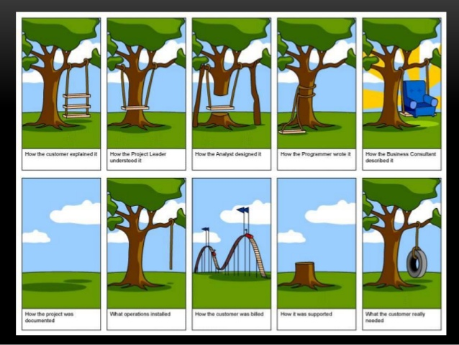

Slide 6
Types of Requirements
Broadly requirements can be categorized into
Functional
Non Functional
Domain requirements
Functional Requirements
The definition of a functional requirement is:
“Any Requirement Which Specifies What The System Should Do.”
In other words, a functional requirement will describe a particular behavior of function of the system when certain conditions are met, for example: “Send email when a new customer signs up” or “Open a new account”.
A functional requirement for an everyday object like a cup would be: “ability to contain tea or coffee without leaking”.

Slide 7
Cont…
Types of Requirements
Some of the more typical functional requirements include:
  Business Rules
  Transaction corrections, adjustments and cancellations
  Administrative functions
  Authentication
  Authorization levels
  Audit Tracking
  External Interfaces
  Certification Requirements
  Reporting Requirements
  Historical Data
  Legal or Regulatory Requirements
So what about Non-Functional Requirements? What are those, and how are they different?
Simply put, the difference is that non-functional requirements describe how the system works, while functional requirements describe what the system should do.
The definition for a non-functional requirement is that it essentially specifies how the system should behave and that it is a constraint upon the systems behaviour. One could also think of non-functional requirements as quality attributes for of a system.

Slide 8
Non-Functional
These are basically the quality constraints that the system must satisfy according to the project contract. The priority or extent to which these factors are implemented varies from one project to other. They are also called non-behavioral requirements.
They basically deal with issues like:
      Portability
      Security
      Maintainability
      Reliability
      Scalability
      Performance
      Reusability
      Flexibility

Slide 9
Differences between Functional and Non Functional Requirements
Functional Requirements | Non Functional Requirements
A functional requirement defines a system or its component. | A non-functional requirement defines the quality attribute of a software system.
It specifies “What should the software system do?” | It places constraints on “How should the software system fulfill the functional requirements?”
Functional requirement is specified by User. | Non-functional requirement is specified by technical peoples e.g. Architect, Technical leaders and software developers.
It is mandatory. | It is not mandatory.
It is captured in use case. | It is captured as a quality attribute.
Defined at a component level. | Applied to a system as a whole.
Helps you verify the functionality of the software. | Helps you to verify the performance of the software.
Functional Testing like System, Integration, End to End, API testing, etc are done. | Non-Functional Testing like Performance, Stress, Usability, Security testing, etc are done.
Usually easy to define. | Usually more difficult to define.

Slide 10
Domain Requirement
What is domain requirement in software engineering?
Domain requirements engineering is a continuous process of proactively defining the requirements for all foreseeable applications to be developed in the software product line. A particular issue for domain requirements engin- eering is to identify and explicitly document the external variability.
In this manner, what are the types of requirements?
The requirements, which are commonly considered, are classified into three categories, namely, functional requirements, non-functional requirements, and domain requirements. IEEE defines functional requirements as 'a function that a system or component must be able to perform.

Slide 11
Domain Requirement Cont…
One may also ask, what does domain mean in software?
A domain is a field of study that defines a set of common requirements, terminology, and functionality for any software program constructed to solve a problem in the area of computer programming, known as domain engineering. The word domain is also taken as a synonym of application domain.
Beside this, what is requirement definition in software engineering?
Software Engineering | Classification of Software Requirements. According to IEEE standard 729, a requirement is defined as follows: A condition or capability that must be met or possessed by a system or system component to satisfy a contract, standard, specification or other formally imposed documents.

Slide 12
Domain Requirement Cont…
What is requirement engineering and its types?
Requirements can range from high-level abstract statements of services or system constraints to detailed mathematical functional specifications. Requirements Engineering is the process of establishing the services that the. customer requires from the system and the constraints under which it is to be.

Slide 13
Requirement Engineering
Requirement Engineering is the process of defining, documenting and maintaining the requirements. It is a process of gathering and defining service provided by the system.

Slide 14
Stages in Requirements Engineering
Inception
Elicitation
Elaboration
Negotiation
Specification
Validation
Requirements management

Slide 15
Stages in Requirements Engineering cont
Inception—ask a set of questions that establish …
  basic understanding of the problem
  the people who want a solution
  the nature of the solution that is desired, and
  the effectiveness of preliminary communication and collaboration between the customer and the developer
Elicitation—elicit requirements from all stakeholders
Elaboration—create an analysis model that identifies data, function and behavioral requirements
Negotiation—agree on a deliverable system that is realistic for developers and customers

Slide 16
Stages in Requirements Engineering Cont..
Specification—can be any one (or more) of the
following:
  A written document
  A set of models
  A formal mathematical
  A collection of user scenarios (use-cases)
  A prototype
Validation—a review mechanism that looks for
  errors in content or interpretation
  areas where clarification may be required
  missing information
  inconsistencies (a major problem when large products or systems are engineered)
  conflicting or unrealistic (unachievable) requirements.
Requirements management
  is a set of activities
  help the project team identify, control, and track requirements and changes to requirements at any time as the project proceeds

Slide 17
Establish the Ground Work
Identify Stakeholders
A stakeholder as “ anyone who benefits in a direct or indirect way from the system which is being developed.
Recognizing multiple viewpoints
- The Marketing group
- Business Mangers
- Software Engineers
- Support Engineers
Working toward collaboration
  -identify areas of commonality and areas of conflict or inconsistency
  - stakeholders collaborate by providing their view of requirements, but a strong “project champion
  - may make the final decision about which requirements make the cut.
Asking the First Questions
  - context free questions
  - Questions that gain a better understanding of the problem and allows the customer to voice his or her perceptions about a solution
  - Questions focuses on effectiveness of the communication activity itself

Slide 18
Eliciting Requirements
Requirements elicitation (also called requirements gathering) combines elements of problem solving, elaboration, negotiation, and specification. In order to encourage a collaborative , team-oriented approach to requirements gathering, stakeholders work together to identify the problem, propose elements of the solution, negotiate different approaches and specify a preliminary set of solution requirement.
Collaborative Requirements Gathering.
Quality Function Deployment
Usage Scenarios
Elicitation work products

Slide 19
Eliciting Requirements cont..
1. Collaborative Requirements Gathering.
Meetings are conducted and attended by both software engineers and other stakeholders.
Rules for preparation and participation are established.
An agenda is suggested that is formal enough to cover all important points but informal enough to encourage the free flow of ideas.
A “facilitator” (can be a customer, a developer, or an outsider) controls the meeting.
A “definition mechanism” (can be work sheets, flip charts, or wall stickers or an electronic bulletin board, chat room, or virtual forum) is used.

Slide 20
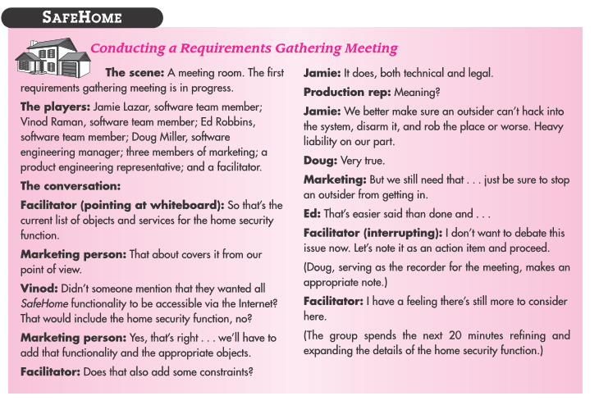
Collaborative Requirements Gathering.

Slide 21
Eliciting Requirements cont..
2. Quality Function Deployment (QFD)
In this technique the customer is asked to prioritize the requirements based on their relative value to the users of the proposed system.
QFD is a technique that translates the needs of the customer into technical requirements for software engineering. QFD identifies three types of requirements:
  Normal requirements: These requirements reflect objectives and goals stated for a product or system during meetings with the customer.
  Expected requirements: These requirements are implicit to the product or system and may be so fundamental that the customer does not explicitly state them.
  Exciting requirements: These requirements reflect features that go beyond the customer’s expectations and prove to be very satisfying when present.
In meeting with the customer, function deployment is used to determine the value of each function that is required for the system. Information deployment identifies both the data objects and events that the systems must consume and produce.
Finally, task deployment examines the behavior of the system within the context of its environment. And value analysis determines the relative priority of requirements determined during each of the three deployments.

Slide 22
Eliciting Requirements Cont…
3.User Scenarios
As requirements are gathered an overall version of system functions and features begins to materialize
Developers and users create a set of scenarios that identify a thread of usage for the system to be constructed in order for the software engineering team to understand how functions and features are to be used by end-users.

Slide 23
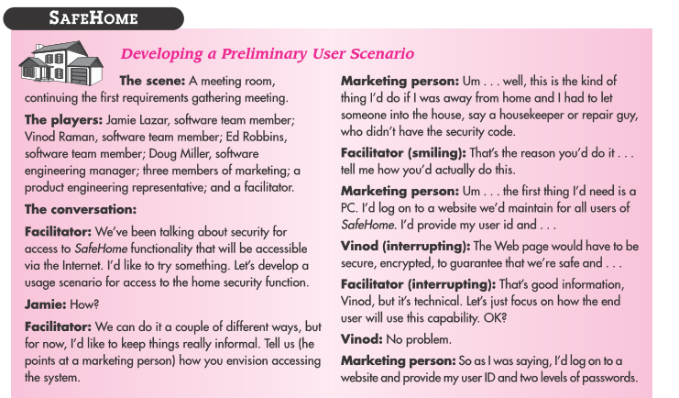
Usage Scenarios

Slide 24
Eliciting Requirements Cont…
4. Elicitation Work Products
For most systems, the work product includes:
A statement of need and feasibility.
A bounded statement of scope for the system or product.
A list of customers, users, and other stakeholders who participated in requirements elicitation.
A description of the system’s technical environment.
A list of requirements (preferably organized by function) and the domain constraints that apply to each.
A set of usage scenarios that provide insight into the use of the system or product under different operating conditions.
Any prototypes developed to better define requirements.

Slide 25
Questions:
Explain the requirements engineering process with help of a diagram?
Explain the spiral model of requirements?
Explain in detail on requirements Elicitation and Analysis process?
Elaborate on requirements Discovery and view points?
What are the goals of requirements engineering process?

